Slide 1
Measurement of ionization yields of nuclear recoils in liquid argon using two-phase detector
A. Bondar, A. Buzulutskov, A. Dolgov, E. Grishnyaev, V. Nosov,
V. Oleinikov (speaker), S. Polosatkin , L. Shekhtman, E. Shemyakina, A. Sokolov
Budker Institute of Nuclear Physics (Budker INP), Novosibirsk, Russia
Novosibirsk State University (NSU), Novosibirsk, Russia
Instrumentation for Colliding Beam Physics (INSTR-17)
March 1, 2017
Notes:
Hello everybody!
My name is Vladislav Oleynikov.
I am PhD student is Budker Institute of Nuclear Physics.
The theme of my presentation is “Measurement of ionization yields of nuclear recoils in liquid argon using two-phase detector”

Slide 2
Outline
Our global objectives, current activity, situation with ionization yields
2. Description of a two-phase Cryogenic Avalanche Detector (CRAD)
3. Our recent results on ionization yields in LAr.
4. Future plans
Neutron double-scattering
S1/S2 selection technique
5. Summary
Notes:
I have divided talk into 5 parts.
First of all I’ll tell you about Our global objectives, current activity, situation with ionization yields.
Then I’ll describe a two-phase Cryogenic Avalanche Detector
In the third part I’ll present our results about Ionization yields in LAr.
After this I’ll tell about our Future plans.
And, finally, summarize results.

Slide 3
Our global objective
Development of liquid Ar detectors of ultimate sensitivity for dark matter search and coherent neutrino nucleus scattering experiments and their energy calibration.
Our group is currently conducting researches in the following directions:
Measurement of electroluminescence (EL) yields in two-phase Ar using a 9-liter detector.
Problem of Ar doping with Xe and N2.
Measurement of ionization yields of nuclear recoils in liquid Ar using neutron scattering technique.
Development of new readout technique in two-phase Ar detectors using SiPM-matrices.
Notes:
Our global objectives are Development and energy calibration of liquid Ar detectors of ultimate sensitivity for dark matter search and coherent neutrino nucleus scattering experiments.
Our group is currently conducting researches in the following directions
Measurement of electroluminescence yields in Ar using a 9-liter two-phase detector.
Measurement of ionization yields of nuclear recoils in liquid Ar using neutron scattering technique.
Development of new readout technique in two-phase Ar detectors using SiPM-matrices.

Slide 4
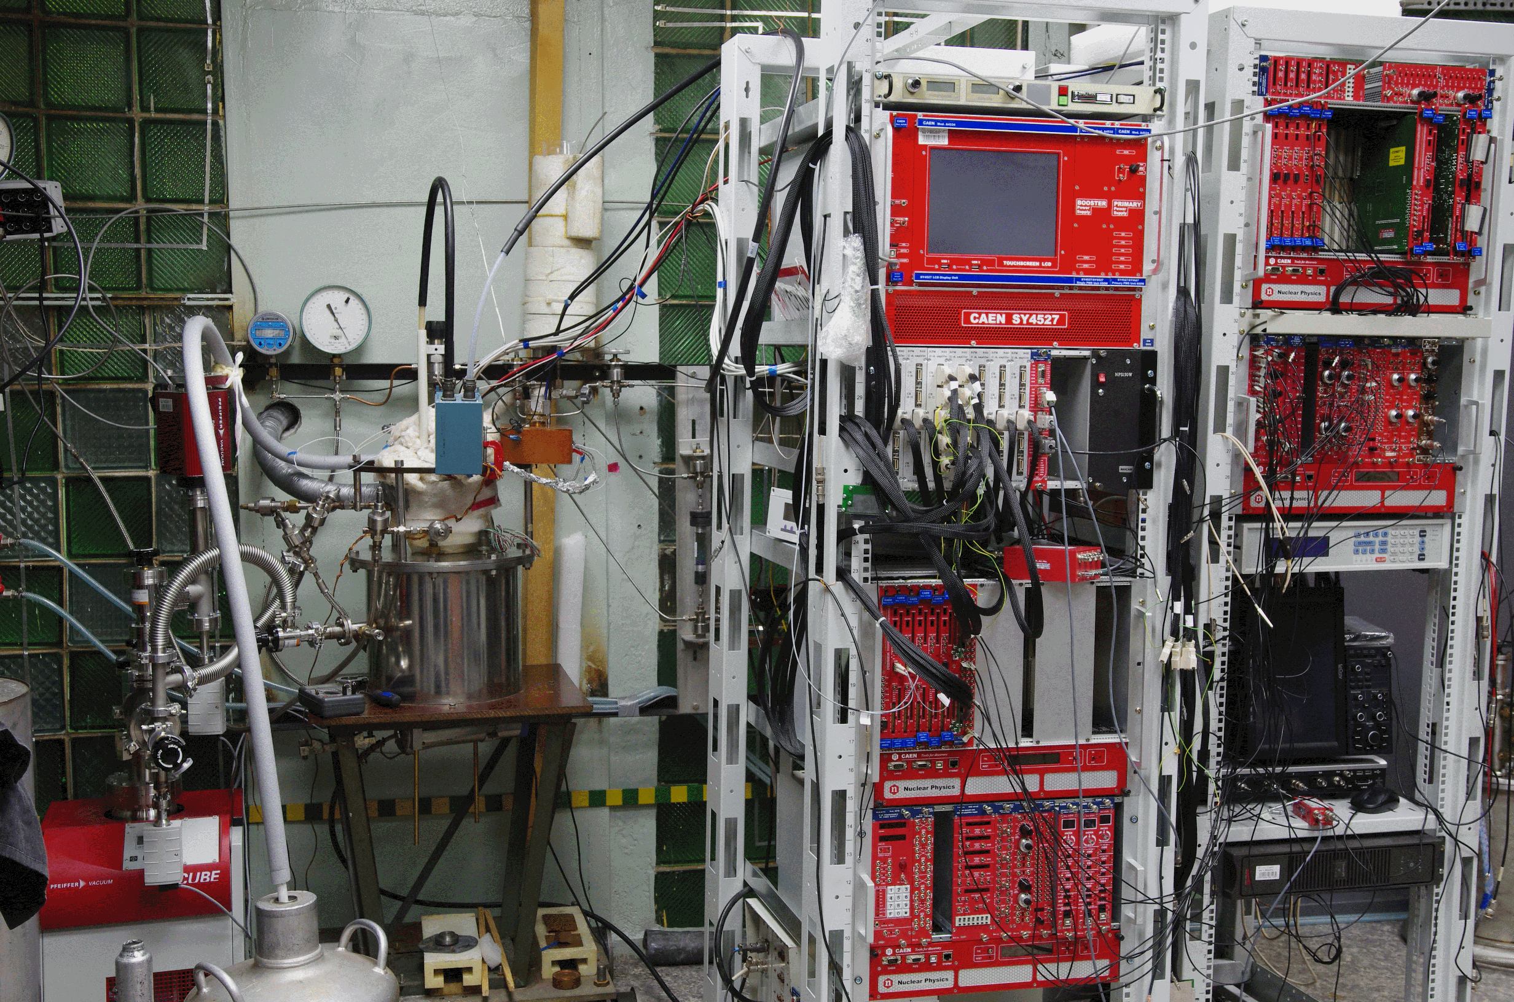
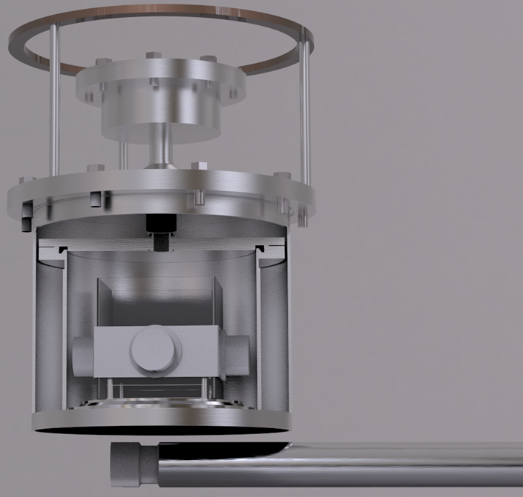
Experimental setup
9 l two-phase cryogenic chamber
Notes:
Our Experimental setup comprises a vacuum-insulated 9 liters cryogenic chamber filled with 2.5 liters of liquid Ar.
During each cooling procedure Ar was purified from electronegative impurities by Oxisorb filter, providing electron lifetime in the liquid >70 us. (откуда это число?)
The detector was operated in two-phase mode in the equilibrium state.

Slide 5
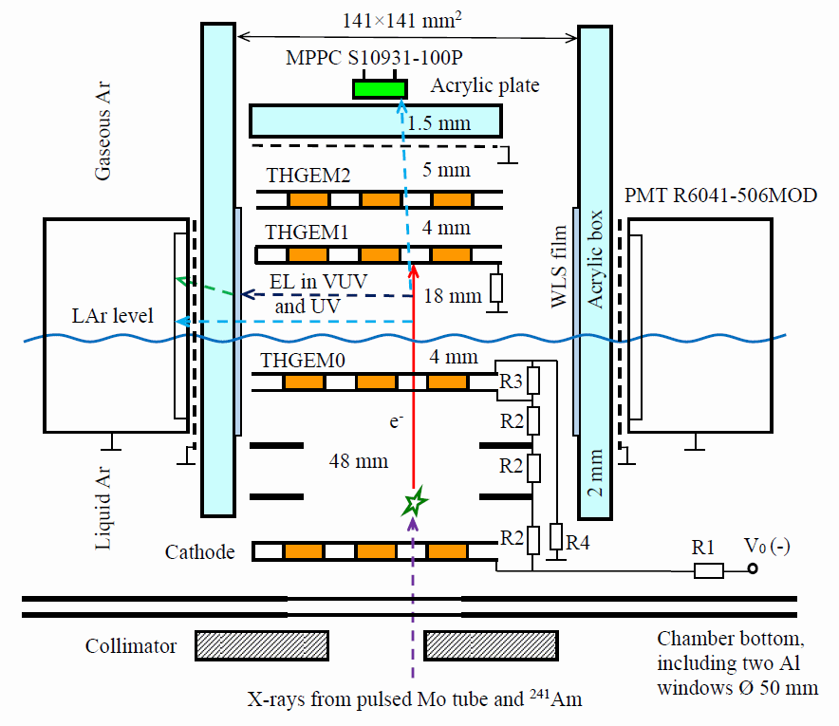
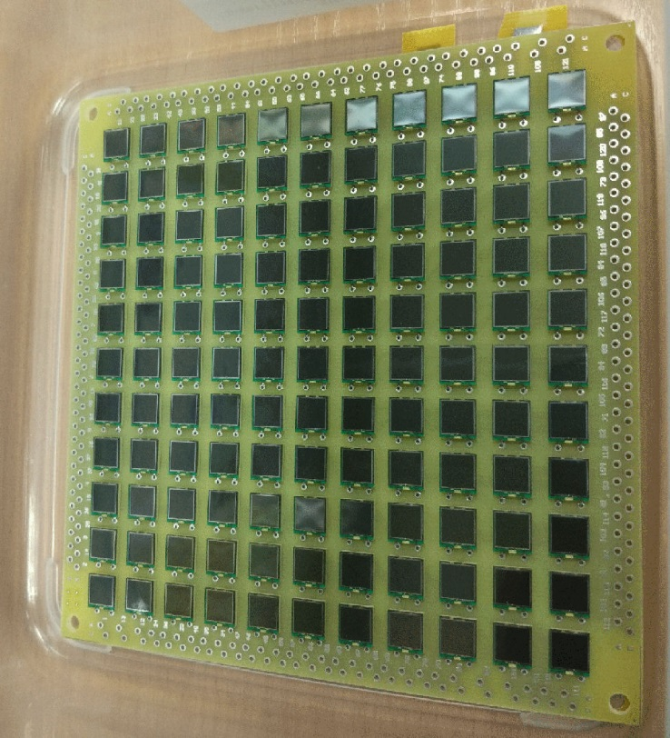
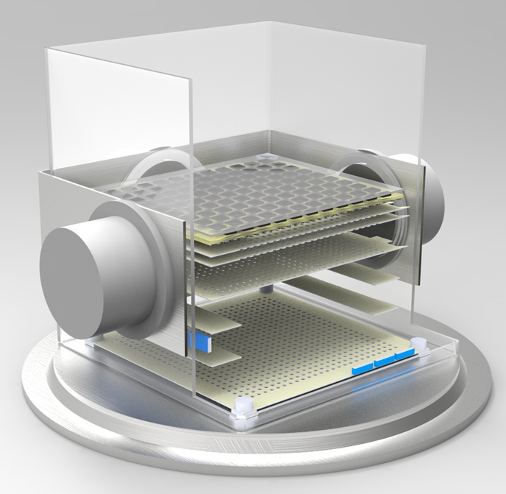
Cryogenic chamber
Hamamatsu
S13360-6050PE
6x6 mm²
11x11 matrix
Notes:
The cryogenic chamber included a cathode electrode (made from a THGEM plate), two field-shaping electrodes and a THGEM0, immersed in a 55 mm thick liquid Ar layer.
A 4 mm thick liquid Ar layer above the THGEM) acted as an electron emission region.
A double-THGEM assembly, consisting of a THGEM1 and THGEM2, was placed in the gas phase above the liquid.
The EL region, 18 mm thick, was formed by the liquid surface and the THGEM1 plate.
There were two ways of optical readout of the EL gap.
Firstly, the gap was viewed by four compact cryogenic PMT, located on the perimeter of the gap.
To prevent discharges and field penetration from the high-voltage region of the EL gap, the PMTs were electrically insulated from the gap a grounded mech and an acrylic protective box of a rectangular shape.
To convert the VUV into the blue light, four wavelength shifter films based on TPB(tetraphenylbutadiene) were deposited on the inner box surface facing the EL gap, in front of each PMT.
Secondly, the scintillation in the spectral range other that VUV (NIR, for example) could be recorded using 11 by 11 SiMP matrix.
To measure ionization yield we use first method.(i.e. only EL signal register by PMTs )
Backup text
The voltage applied to the divider varied from 11 to 22 kV, producing an electric drift field in liquid Ar of 0.34 – 0.68 kV / cm, electric emission fields of 2.6 – 5.1 kV / cm and an electric field in the EL gap of 4.0 – 8.0 kV / cm.

Slide 6
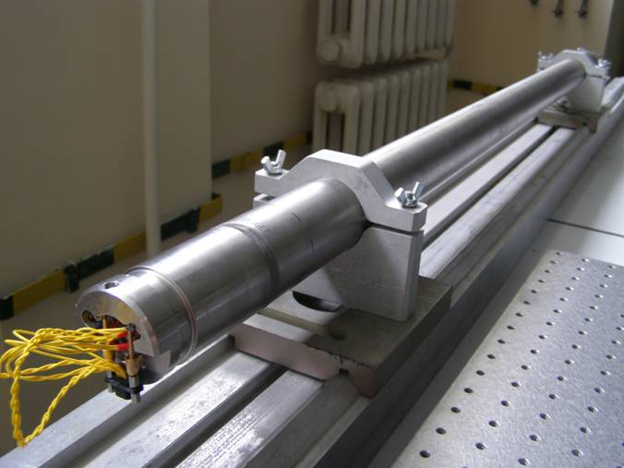
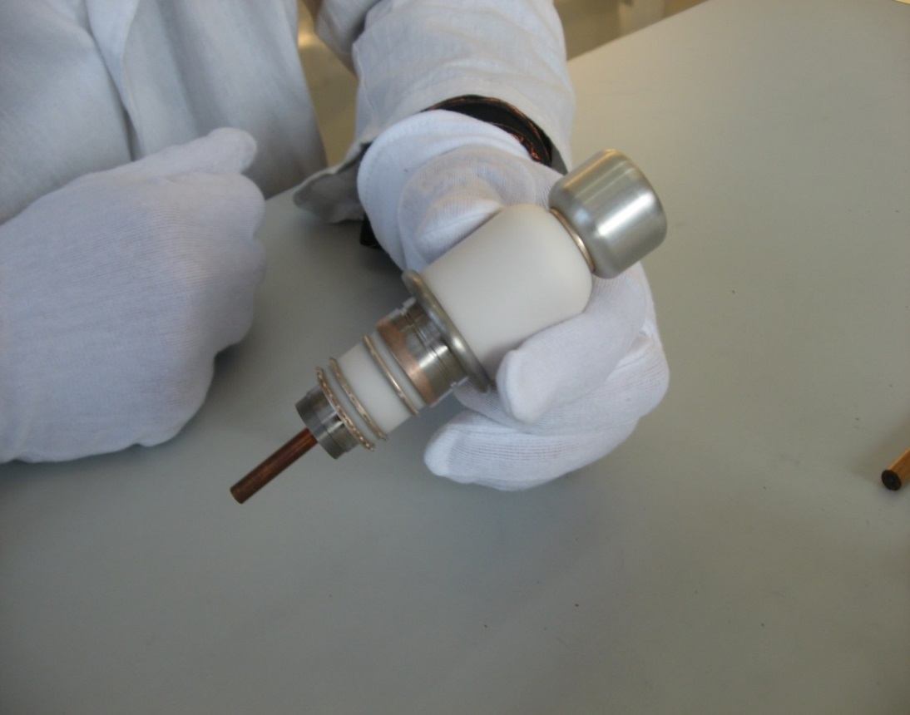
Neutron generator produced in BINP
The generator includes a high voltage source (Cockcroft-Walton multiplier) and gas-filled neutron-generating tube
Design parameters:
Neutron yield: 10⁵ neutrons/s (DD mode)
Continuous or pulse mode
Rated current of ions: 50 uA
Operating voltage: 80 kV
Insulation: SF₆, 8 atm
Notes:
To produce neutrons a specially designed neutron generator was used that continuously emitted monenergistic not collimated neutrons with a kinetic energy of 2.45 MeV obtained in the DD fusion reaction.
The generator includes a high voltage source (Cockcroft-Walton multiplier) and gas-filled neutron-generating tube
The Design parameters of neutron generator are:
Neutron yield: 10⁵ neutrons/s (DD mode) (ten to the fifth power)
Continuous or pulse mode
Rated current of ions: 50 uA
Operating voltage: 80 kV
Insulation: SF₆, 8 atm (sulfur fluorine four at eight atmospheres)

Slide 7
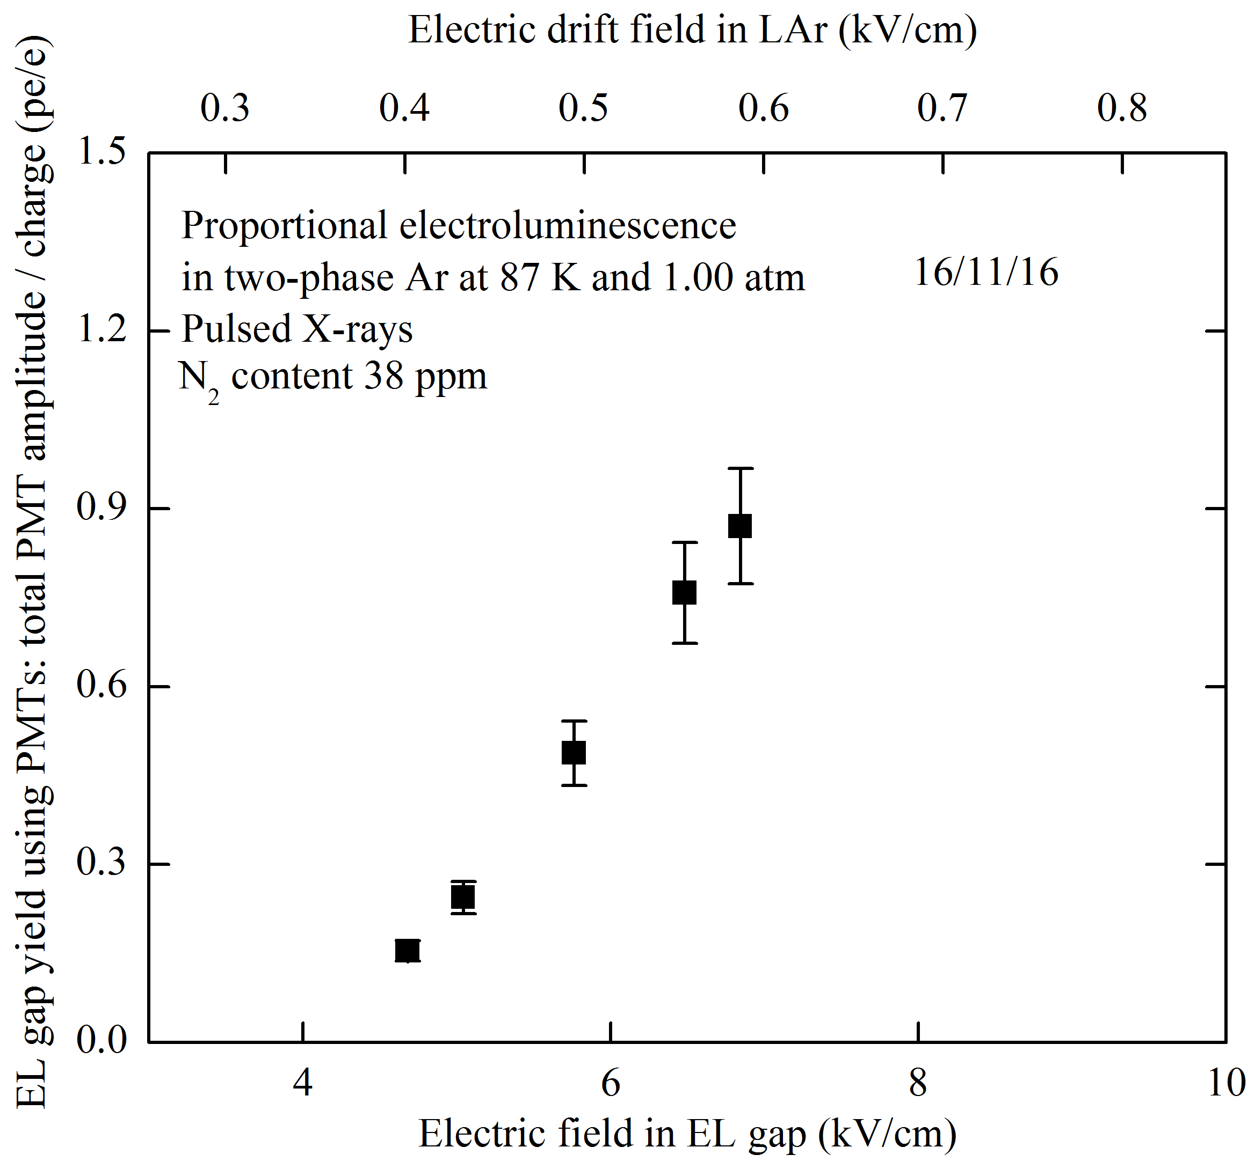
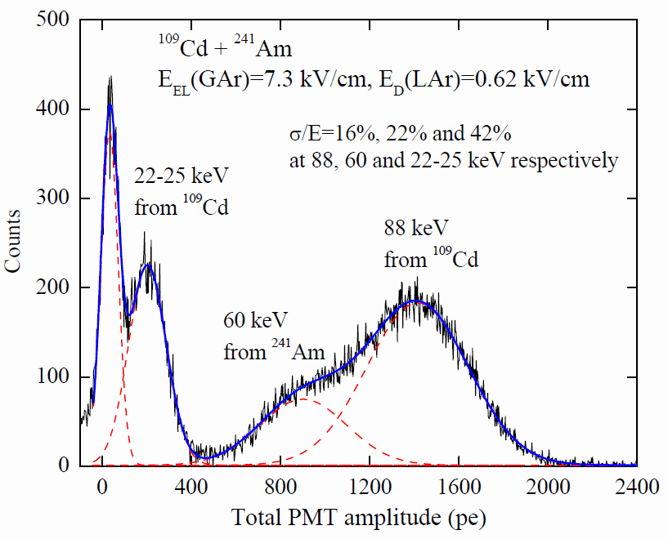
Study of proportional EL in two-phase Ar:
EL yields and amplitude spectra
Надо исправить
High EL gap yield: 15 pe/keV
Good energy resolution: 22% at 60 keV
High EL gap yield, reaching
1.4 pe/e at 7 kV/cm
Notes:
The sensitivity of a particular detector is characterized by EL gap yield.
In our case it can be defined as the number of photoelectrons recorded by the PMT per drifting electron in the EL gap.
The left picture shows the EL gap yield as a function of the electric field in the gap, measured using PMT signal.
The right picture shows the amplitude spectrum of the total PMT signal from the EL gap induced by X-ray from a mixture of the 109Cd (cadmium) and 241Am (americium) radioactive sources, at an electric field of 7.3 kV/cm in thee EL gap and 0.62 kV/cm in the drift region.

Slide 8
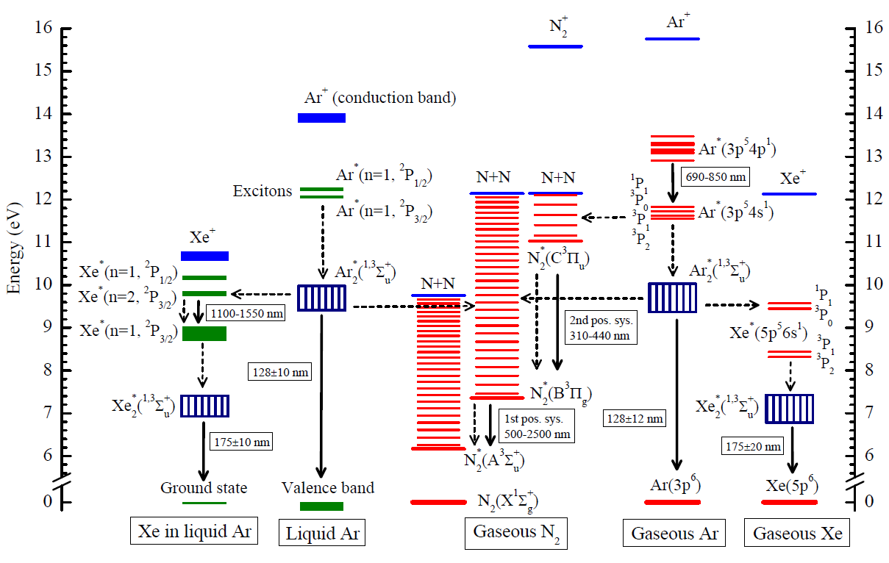
The problem of doping Ar with Xe and N2
Energy levels of the lower excited and ionized states relevant to the ternary mixture of Ar doped with Xe and N2 in the two-phase mode: the most complete compilation over past 50 years. (“Photon emission and atomic collision processes in two-phase argon doped with xenon”, A. Buzulutskov, Eprint 1702.03612)
Notes:
The problem is currently under study in our group.

Slide 9
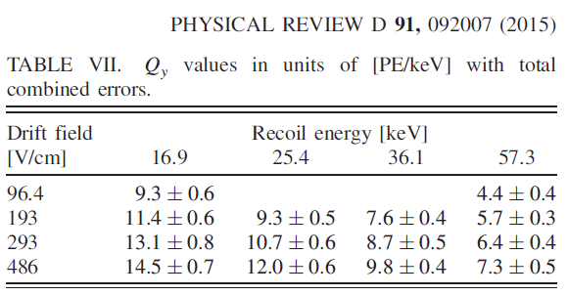
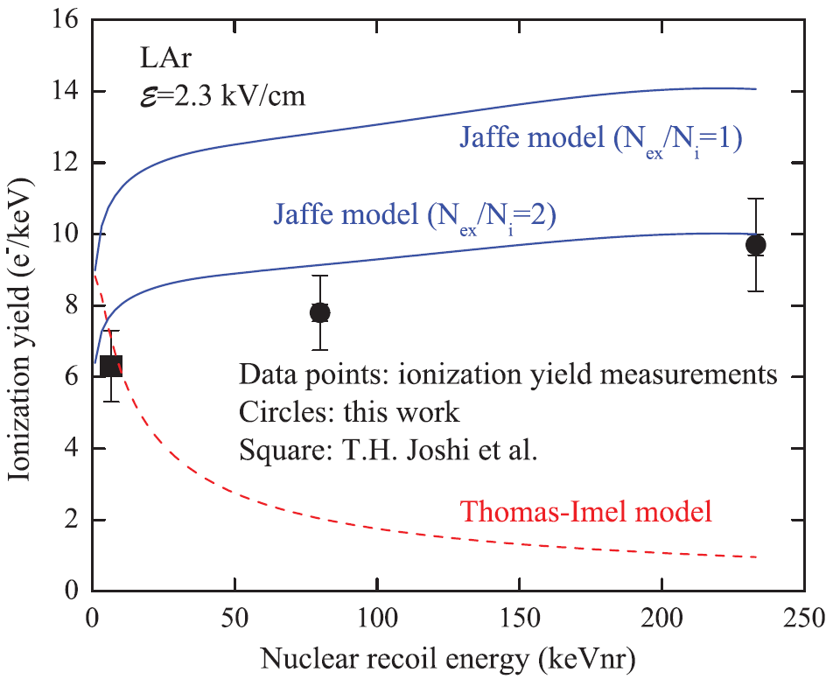
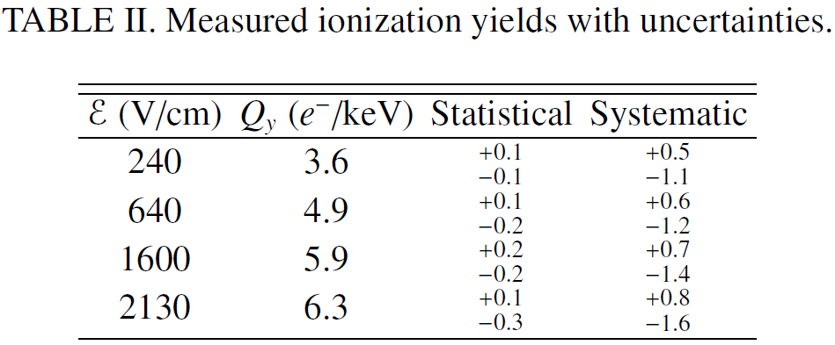
Ionization yield
SCENE experiment
Our previous results
EPL, 108 (2014) 12001
Phys. Rev. Lett., 112
(2014) 171303, 6.7 keVnr
Notes:
The energy calibration of nuclear recoil detectors is of primary importance to rare-event experiments.
Such a calibration, in particular in liquid Ar and Xe detectors media, is usually performed by measuring the ionization yield and scintillation efficiency of nuclear recoil, using neutron elastic scattering on (off ?) nuclei,
which imitating the interaction with dark matter particle or coherently scattered neutrino.
A particle interaction in the liquid phase produces primary scintillation (S1) and ionization . The electrons are drifted away from the interaction site by an electric field and extracted into the gas where they create secondary scintillation (S2).
The ionization yield is ratio of number of electrons escaping recombination with positive ions (ne) and the energy deposited by a nuclear recoil (E).
It depends on deposited energy (E) and on the electric field (epsilon).
While for liquid Xe there are ample experimental data on such yields, little is known about the ionization yield and scintillation efficiency in liquid Ar.
Recently the first results on the ionization yield of nuclear recoils in liquid argon have been presented in the low energy range: from 17 to 57 keV (SCENE experiments, see top right picture) and at point 6.7 keV (bottom right picture).
Also recently we have measured ionization yield at 80 and 233 keV.
In present work ionization yield of nuclear recoils in liquid Ar has been measured at high energy 233 keV for several eclectic fields and complements low energy data.

Slide 10
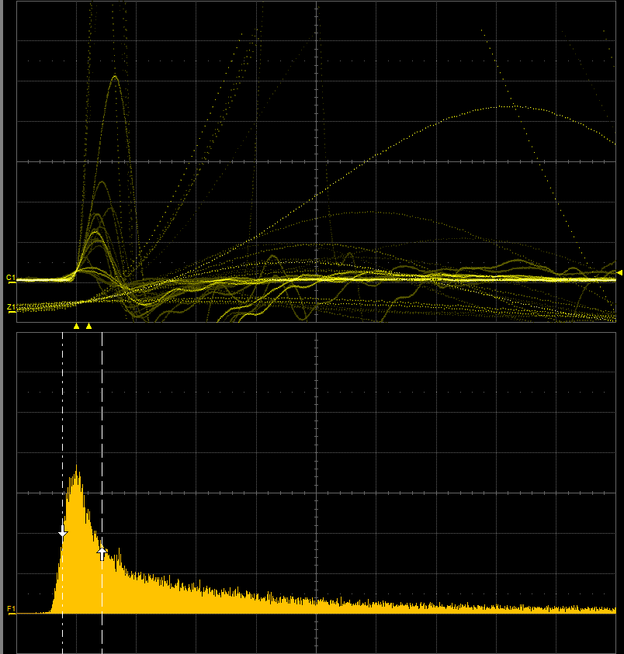
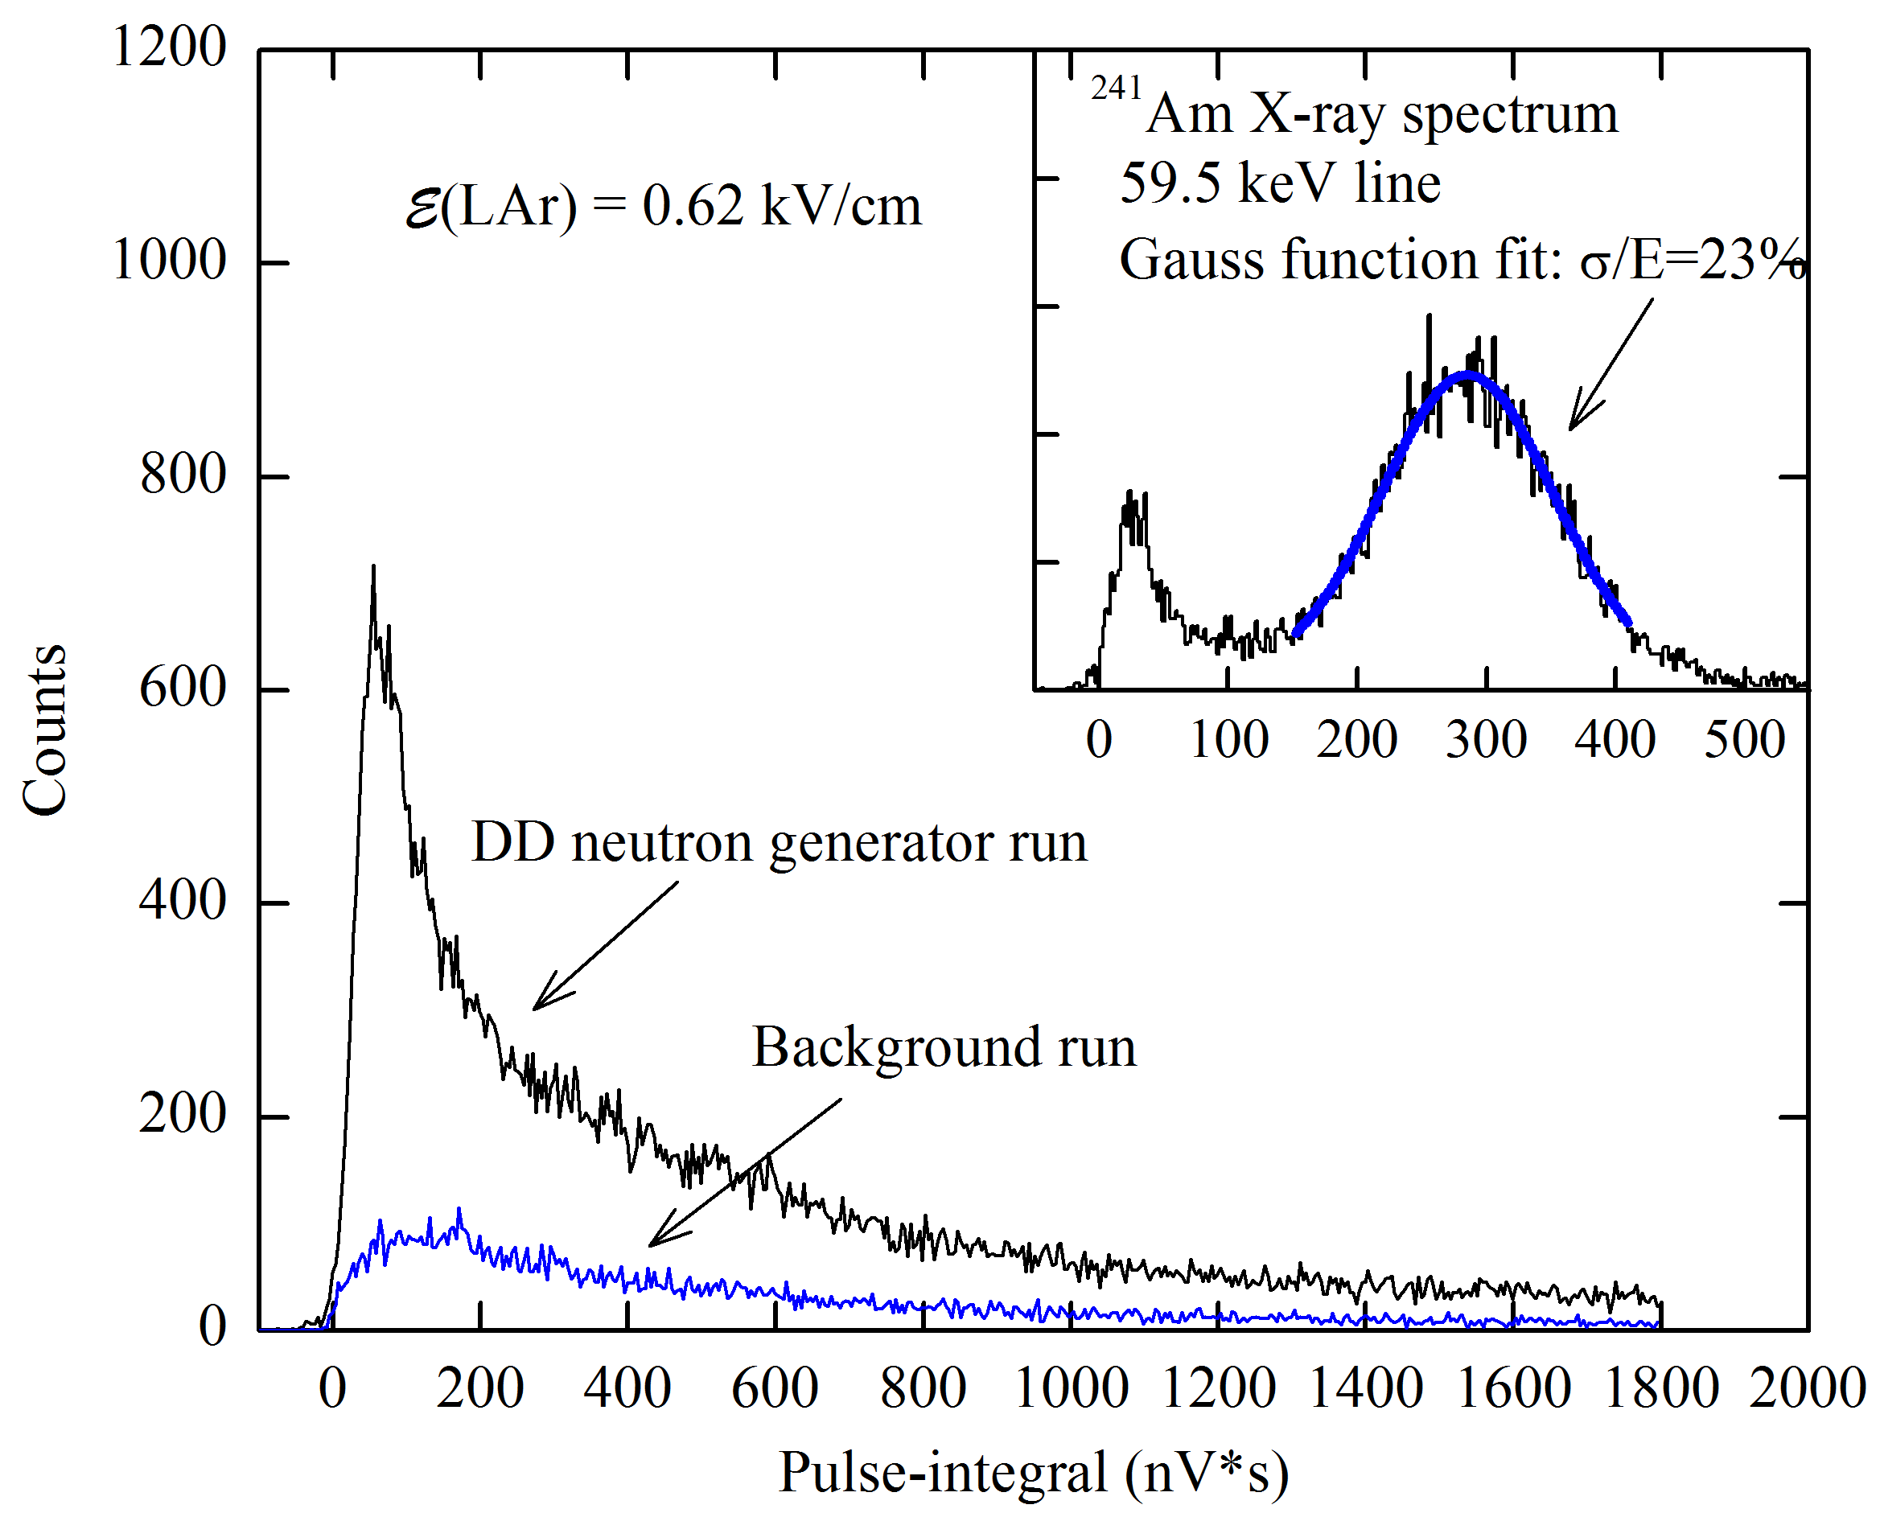
Measurement of ionization yield: raw signals and a measurement circuit
Notes:
I have describe setup and its main parameters and now I’ll discuss Measurement of ionization yield.
The primary ionization charge in liquid Ar was produced by either 60 keV gamma from Am241 or 2.45 MeV neutron from DD-generator.
On the left picture you can see typical oscillogram with raw signal and integral spectra for neutrons.
On the right picture the integral spectra for gamma, neutron and background runs are shown.

Slide 11
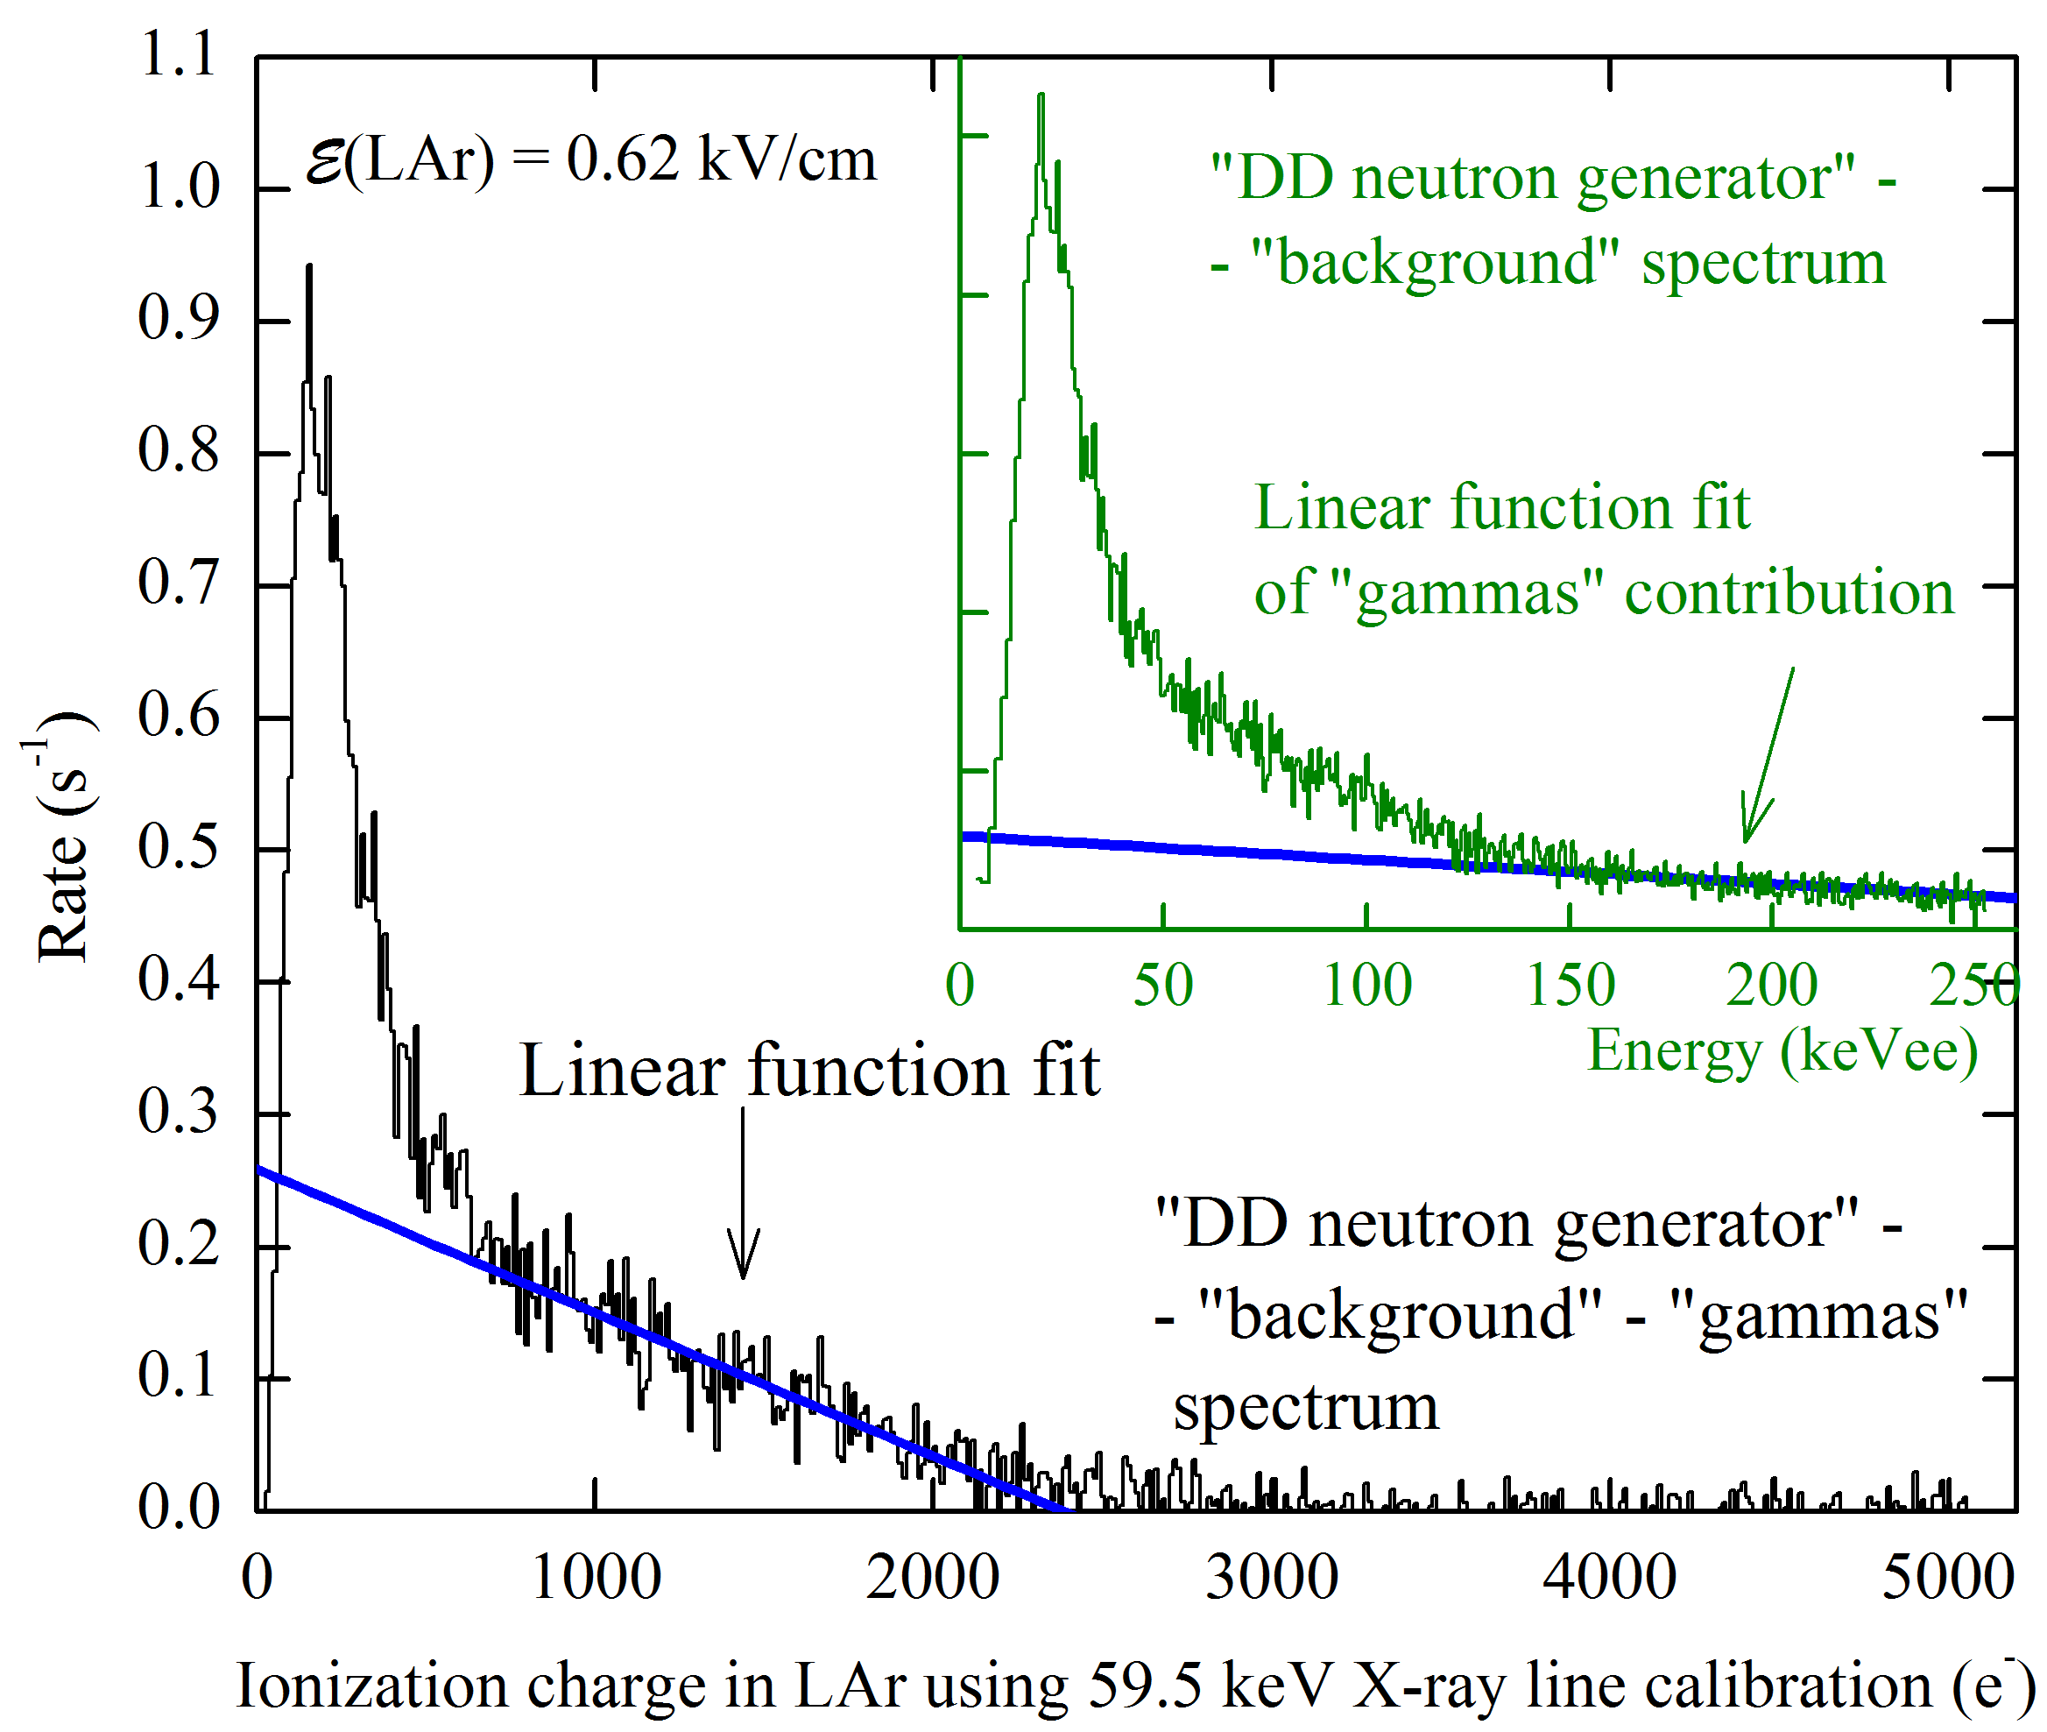
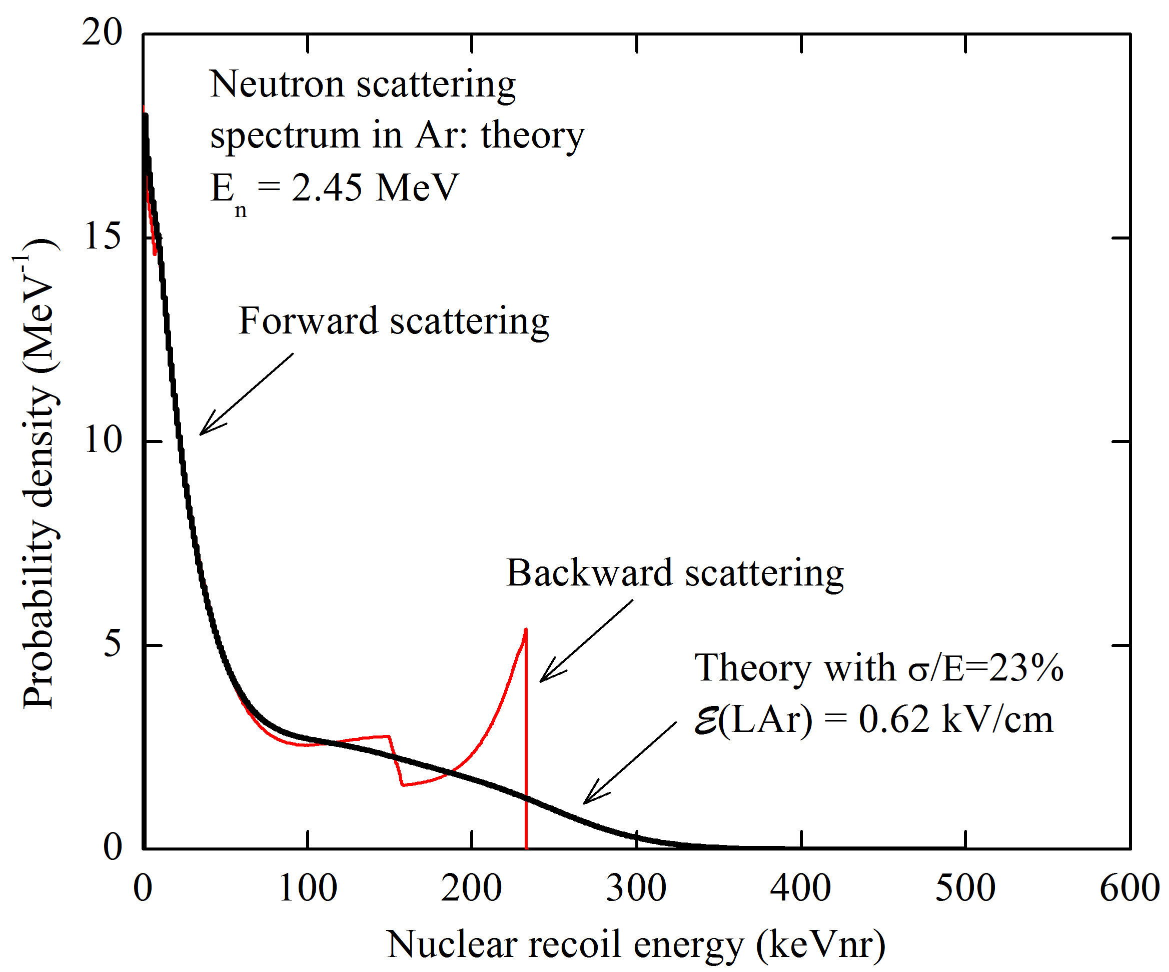
Measurement of ionization yield: experimental and theoretical spectra
Notes:
To measure ionization yield one should first determine ne from the spectra.
For this pulse integral should be normalized to that of 60 keV peak and that converted to primary ionization charge.
After subtracting the background-run contribution, the amplitude distribution still contains the gamma-ray background, resulted from radiative capture in surrounding materials.
Gamma rays produced in this reaction have energy above 600 keV, so an energy spectrum due to Compton scattering can be approximated by a linear decreasing function with energy (see top image on the left picture)
On the left picture and bottom image you can see the desired ionization charge spectrum.
The next step is to compare this experimental spectrum to the theoretical one.
The theoretical spectrum was computed using differential cross-section of elastic and inelastic neutron scattering (red curve on the right picture).
And, finally, this spectrums was convolved with energy resolution function (see black curve).
Ionization yield was calculated by dividing the end point of experimental spectrum to the theoretical one.

Slide 12
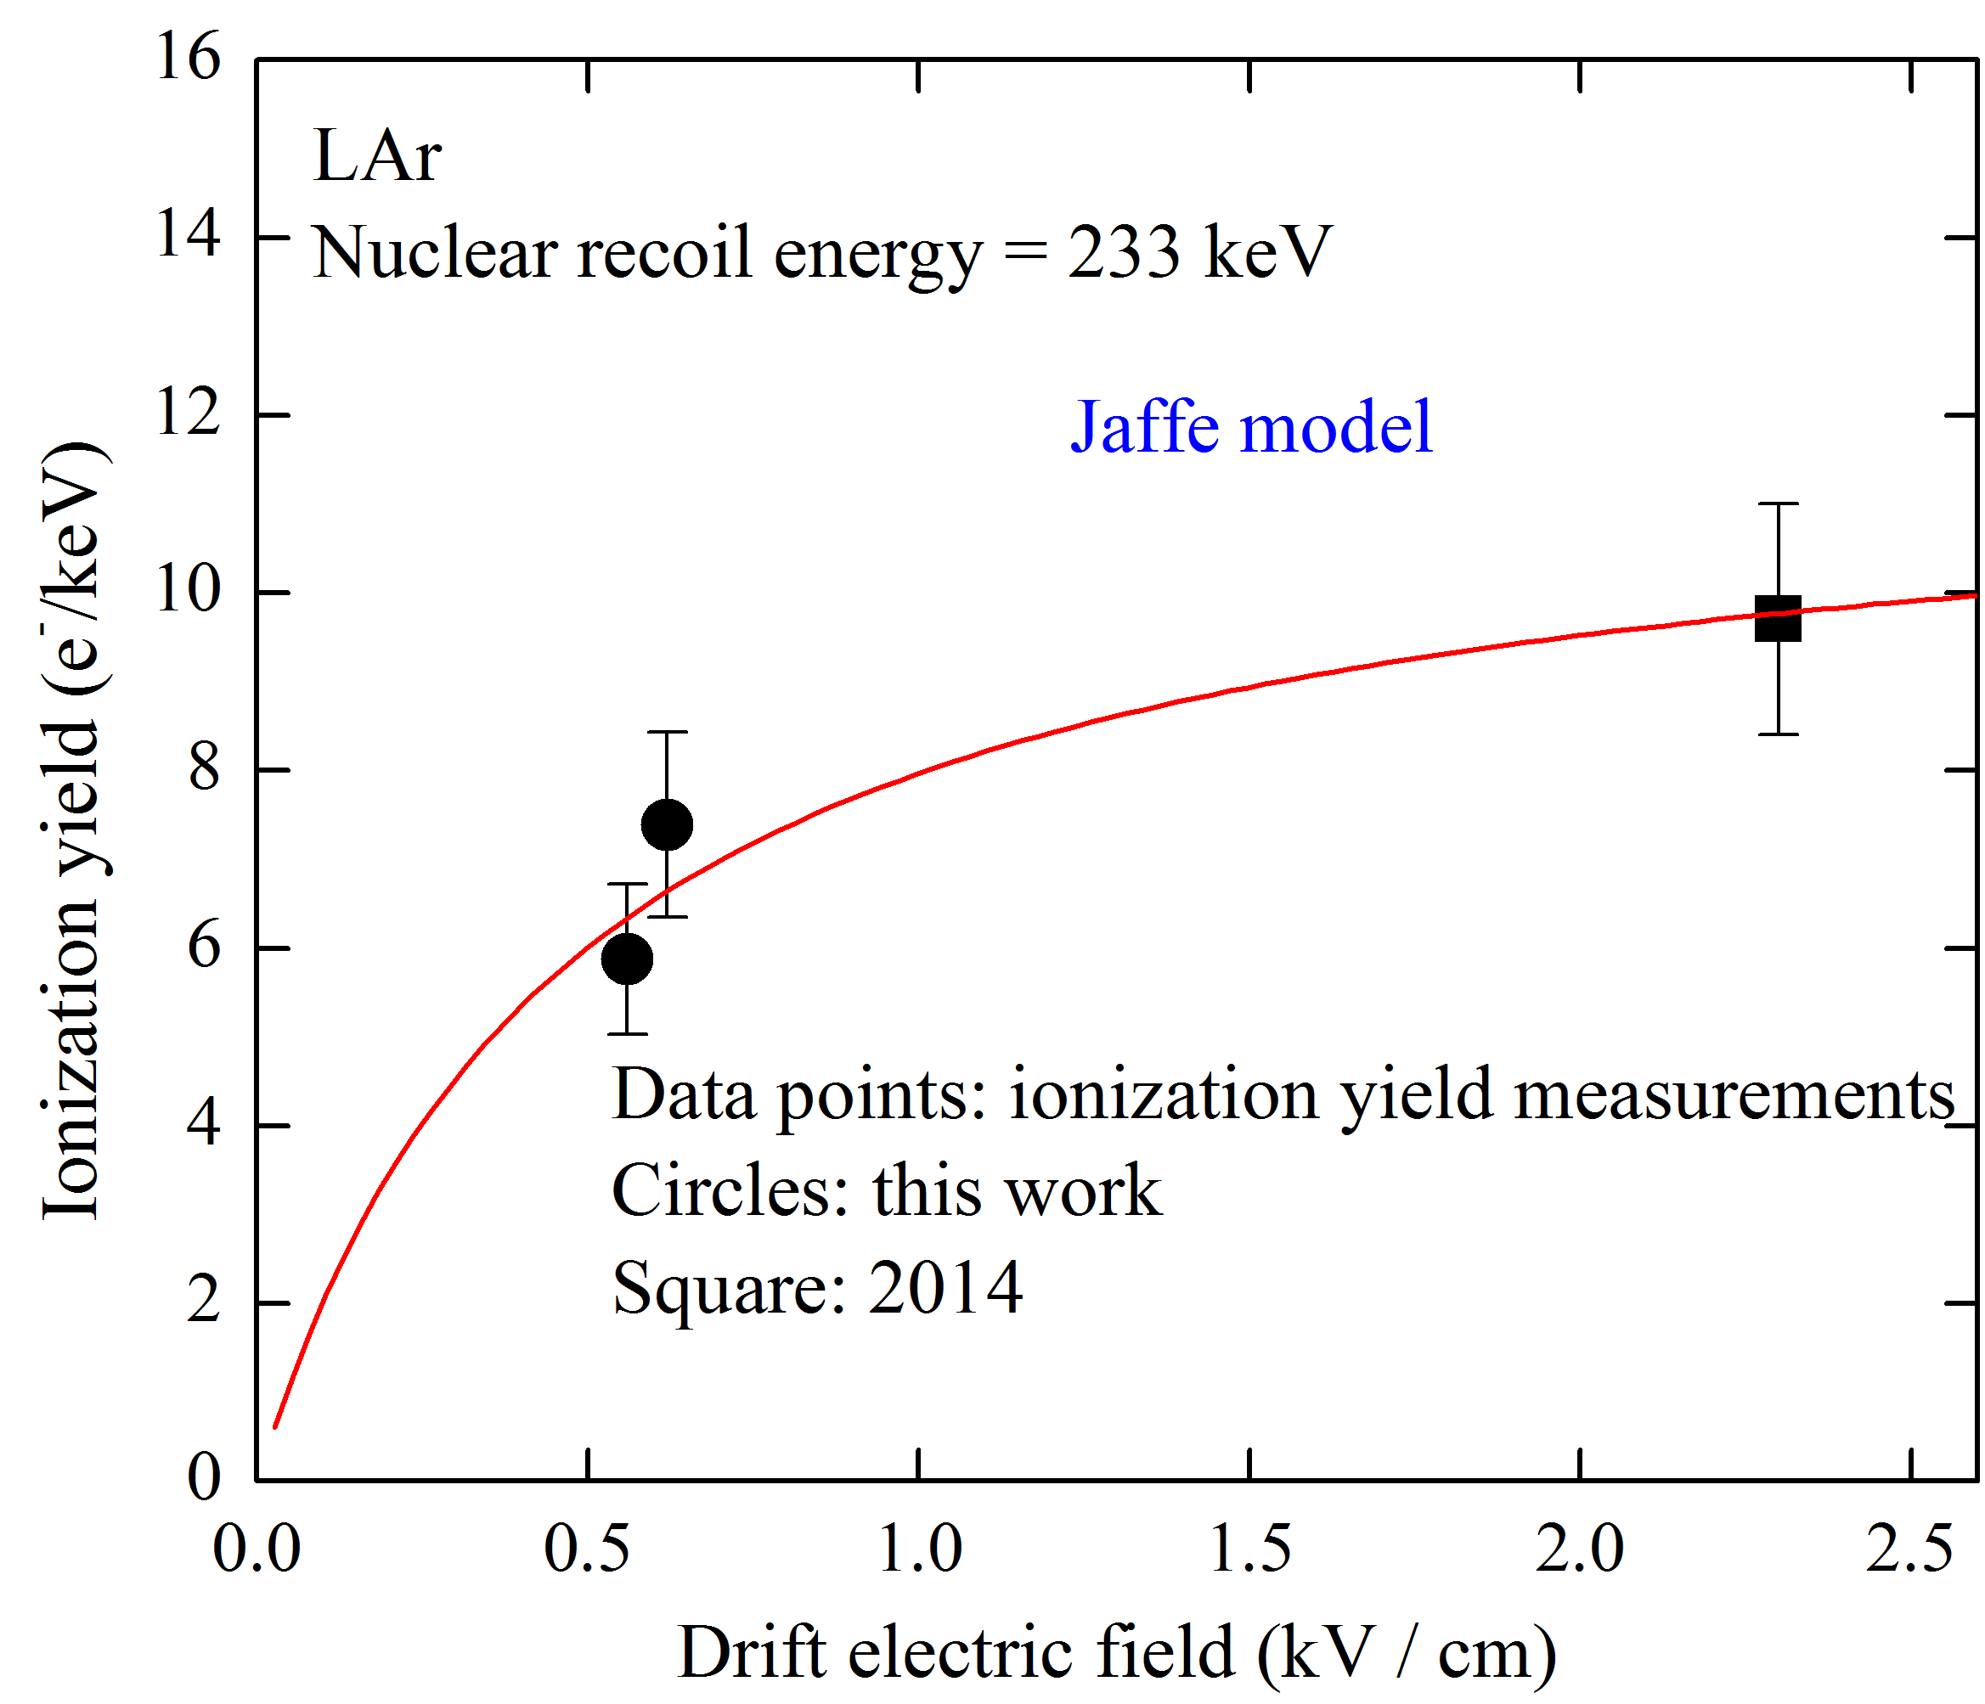

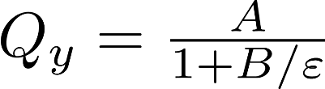
Measurement of ionization yield: results
Ionization yield:
5.9 +- 0.8 and 7.4 +- 1 e-/keV at 0.56 and 0.62 kV/cm
Field dependence is well described by Jaffe model
Notes:
On the graph you can see ionization yield as a function of electric field for two data sets:
Square for previous data obtained in 2014 and circles for current data.
Red curve is a fit function of Jaffe model.
Field dependence is well described by Jaffe model
Systematic error is dominant and occurs because of calibration using LAr ionization yield for electron recoil.

Slide 13
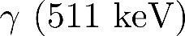
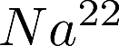
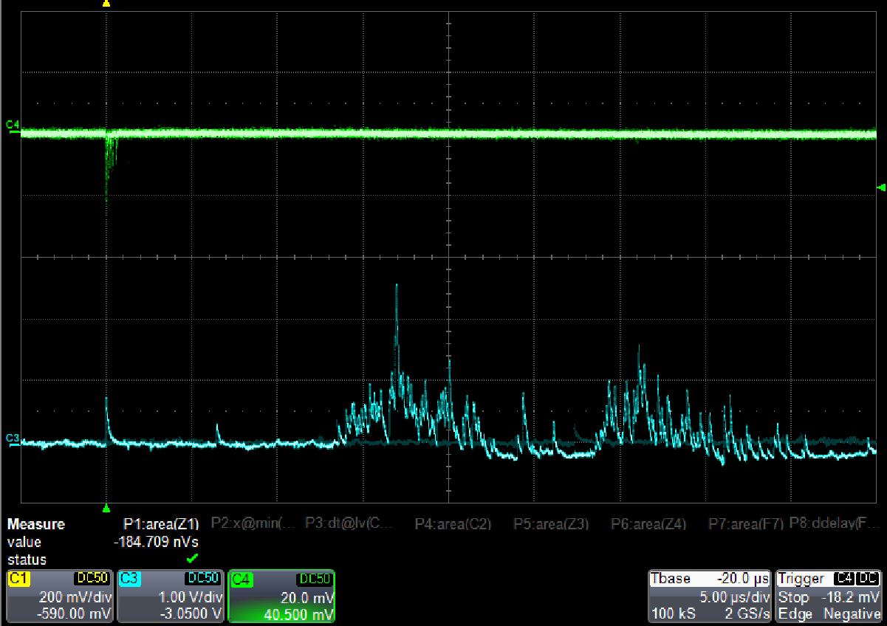
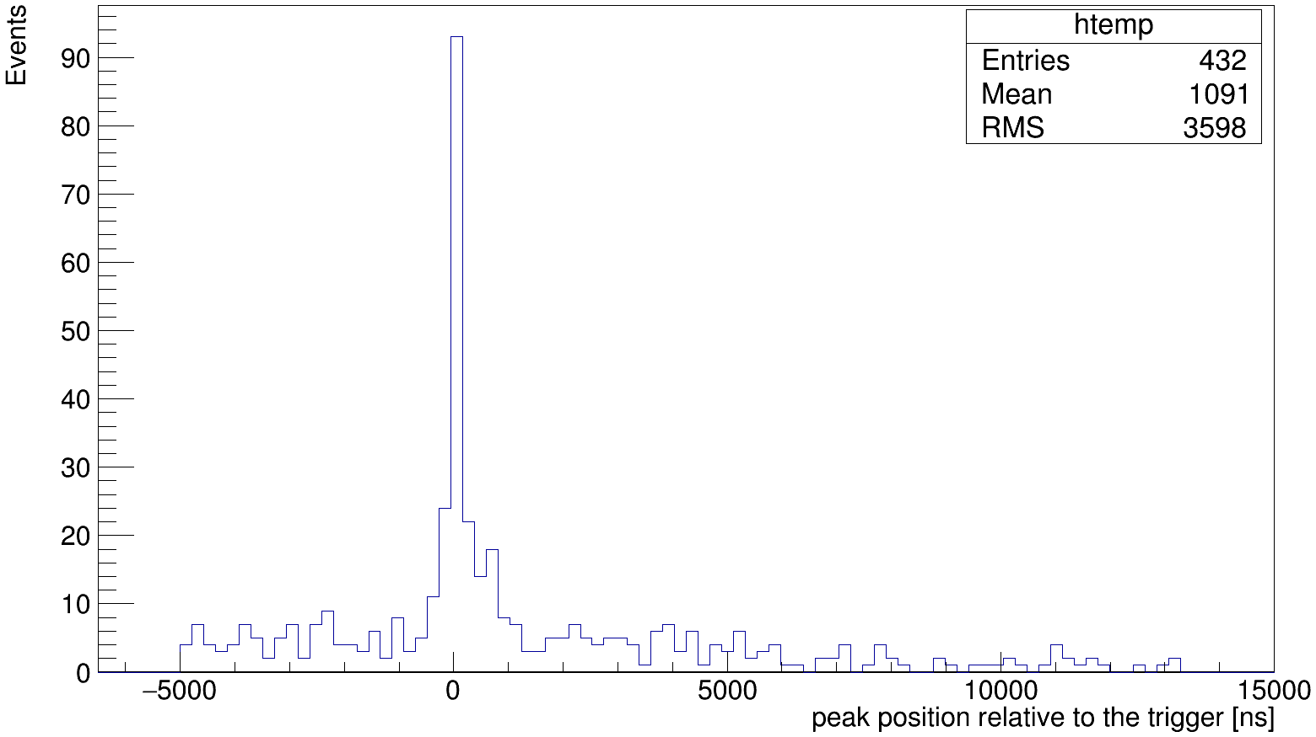
Nuclear recoil selection using S1 / S2 comparison
BGO + PMT
LAr TPC
Trigger (BGO + PMT)
S2
S1
Random coincidence
Notes:
Previously we used spectra subtraction to reject background events.
But also there is opportunity to use S2 S1 ratio as discriminator factor for nuclear and electron recoil.
We irradiated LAr TPC by sodium 22 isotope, which produce two gamma quanta.
One of them was registered by PMT with BGO crystal and produced trigger and another was registered by TPC.
You can see typical signal from detectors on the left picture.
The right picture shows spectrum of peak position time relative to the trigger.
On this spectrum we clearly see peak near trigger time, so signals was really from sodium 22 isotope.
Unfortunately, S1 signal is low because right now we do not have enough acceptance for the S1 signal and separation does not work correctly.
So, we plan to install additional SiMP matrix on the detector bottom and improve light collection.

Slide 14
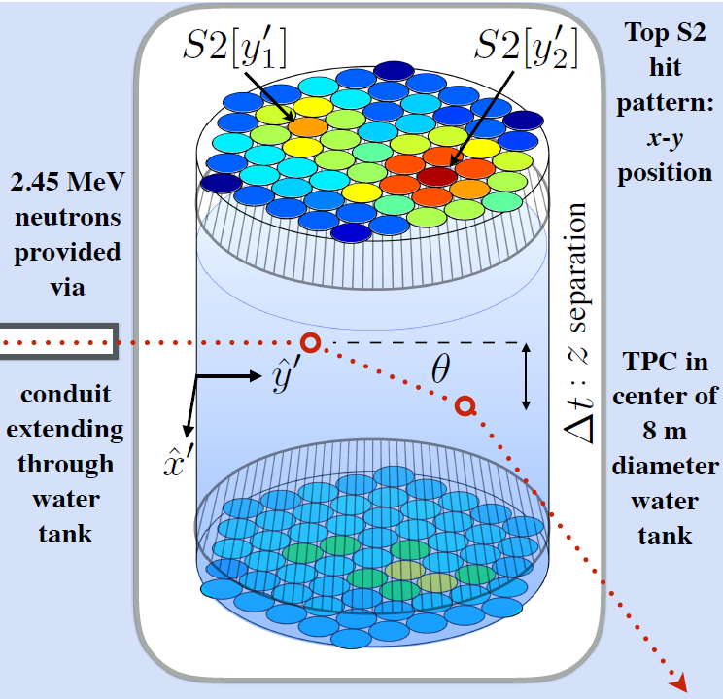
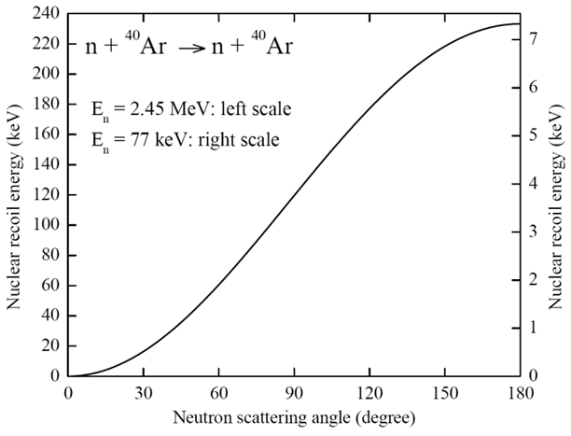
Neutron double-scattering concept for energy calibration at low energies in LAr
LUX
Expe-
riment
Cryostat
SiPM matrix
α
n
10cm
n
D-D neutron generator
Having high spatial resolution in detector, of 1 mm, we expect reaching accuracy of about 2º in scattering angle, corresponding to nuclear recoil energy as low as a few keV
Notes:
In the previous year The Large Underground Xenon experiment operating at the Sanford Underground Research Facility in Lead, South Dakota
published results about Low-energy nuclear recoil calibration in LXe.
The main idea of this experiment was to register scattered neutron again in the TPC, called Neutron double-scattering concept.
Using x,y,z reconstructed coordinates for both interaction they found scattering angle theta which is associated with recoil energy.
With this method they measured ionization yield up to 0.7 keV of nuclear recoil.
We want to measure ionization yield in our experiment for LAr using Neutron double-scattering too.
The Bottom right picture shows recoil energy dependence as a function of the neutron scattering angle.
Having high spatial resolution in detector, of 1 mm, we expect reaching accuracy of about 2º in scattering angle, corresponding to nuclear recoil energy as low as a few keV

Slide 15
Summary
-Measurement of electroluminescence (EL) yields in two-phase Ar using a 9-liter detector.
-Problem of Ar doping with Xe and N2.
-Продолжаются измерения Ionization yields of nuclear recoils in liquid Ar .. Using neutron scattering в новых диапазонах энергий и полей
-The measurements of ionization yields in LAr using S1/S2 selection and neutron double-scattering techniques are in the course in our lab.
- These studies .. in frame of ..DarkSide dark matter search experiment
Notes:
To sum up,

Slide 16
Backup slides

Slide 17
Novosibirsk group presentation
Novosibirsk group on rare-event instrumentation operates within both Budker Institute of Nuclear Physics (BINP) and Novosibirsk State University (NSU), in the frame of Lab 3 (BINP) and LCEP (Laboratory of Cosmology and Elementary Particles of Physics Department of NSU).
Also, we have recently joined DarkSide20k collaboration.
Group management:
A. Buzulutskov (leader), A. Bondar (deputy director of BINP and dean of Physics Department of NSU), A. Dolgov (head of LCEP).
Group members:
A. Sokolov (senior scientist), L. Shekhtman (leading scientist), V. Nosov (engineer), R. Snopkov (engineer), E. Shemyakina (PHD student), V. Oleinikov (PHD student), A.Chegodaev (technician).
We also collaborate with S. Polosatkin and E. Grishnyaev from Plasma Division (BINP) on DD neutron generator development.
Notes:
Novosibirsk group on rare-event instrumentation operates within both Budker Institute of Nuclear Physics (BINP) and Novosibirsk State University (NSU), in the frame of Lab 3 (BINP) and LCEP (Laboratory of Cosmology and Elementary Particles of Physics Department of NSU).
Also, we have recently joined DarkSide20k collaboration

Slide 18
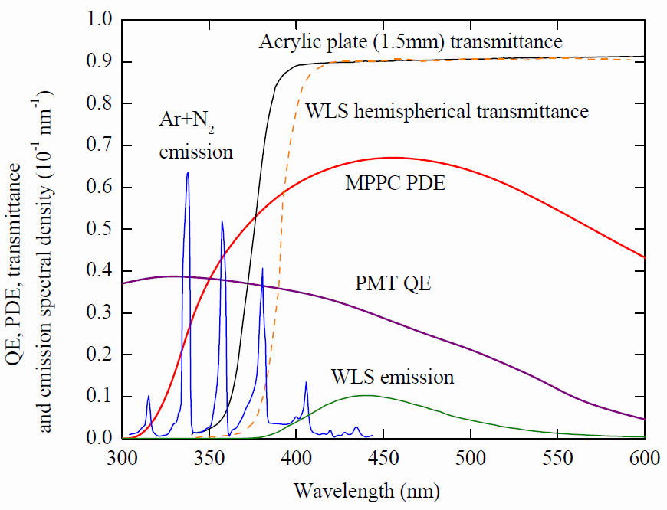
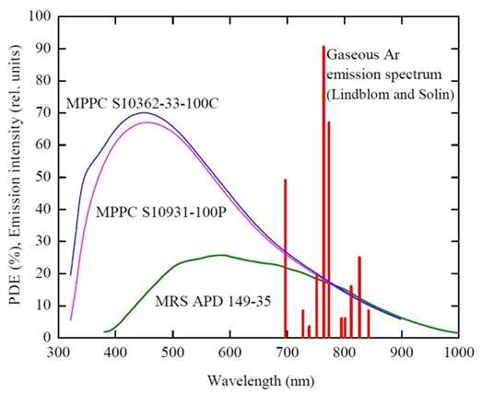
Optical spectra

Slide 19
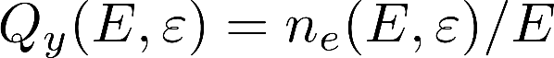
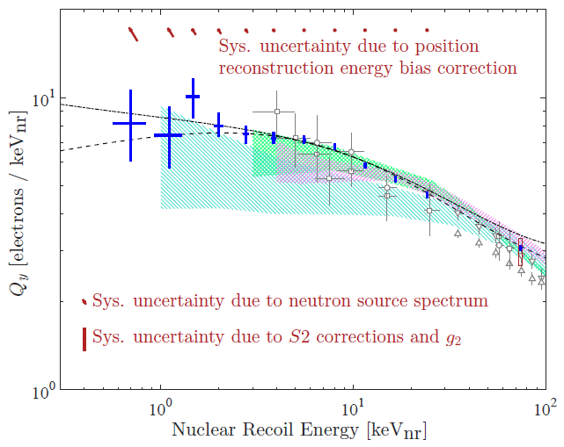
Ionization yield
(LXe): 0.7 – 100 keVnr
SCENE experiment (LAr):
17 – 57 keVnr, but in [PE/keVnr]
Notes:
The energy calibration of nuclear recoil detectors is of primary importance to rare-event experiments.
Such a calibration, in particular in liquid Ar and Xe detectors media, is usually performed by measuring the ionization yield and scintillation efficiency of nuclear recoil, using neutron elastic scattering on (off ?) nuclei,
which imitating the interaction with dark matter particle or coherently scattered neutrino.
A particle interaction in the liquid phase produces primary scintillation (S1) and ionization [5]. The electrons are drifted away from the interaction site by an electric field and extracted into the gas where they create secondary scintillation (S2).
The ionization yield is ratio of number of electrons escaping recombination with positive ions (ne) and the energy deposited by a nuclear recoil (E).
It depends on deposited energy (E) and on the electric field (epsilon).
While for liquid Xe there are ample experimental data on such yields, little is known about the ionization yield and scintillation efficiency in liquid Ar.
Recently the first results on the ionization yield of nuclear recoils in liquid argon have been presented in the low energy range.
SCENE collaboration presented results from 17 to 57 keV, but in [PE/keVnr], i.e. detector-dependent units.
6.7 keV and from In present work ionization yield of nuclear recoils in liquid Ar has been measured at high energy 233 keV and complements low energy data.

Slide 20
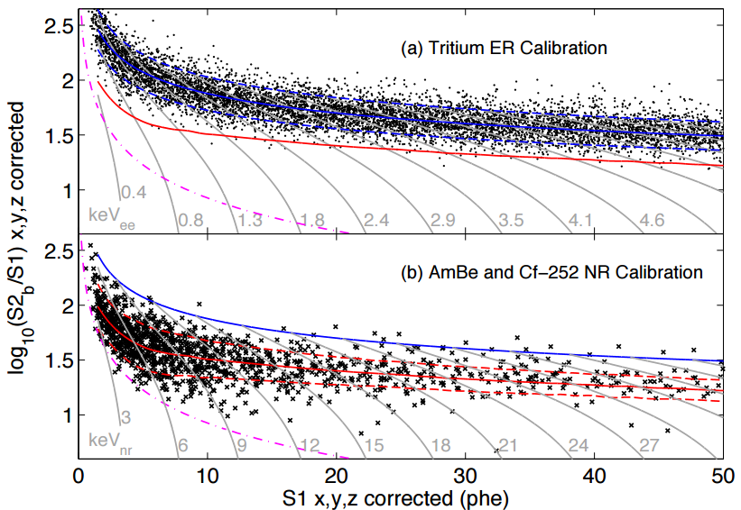
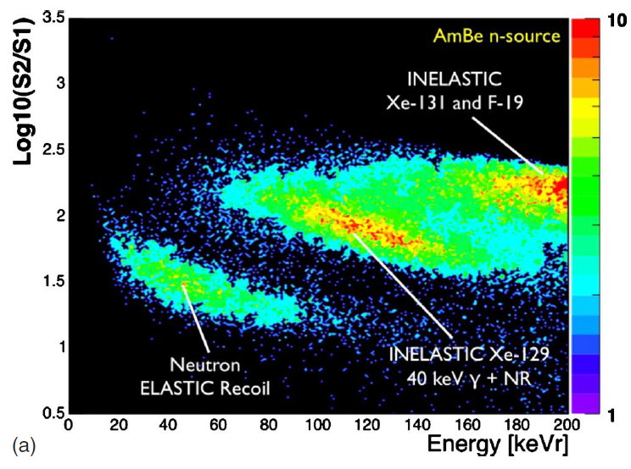
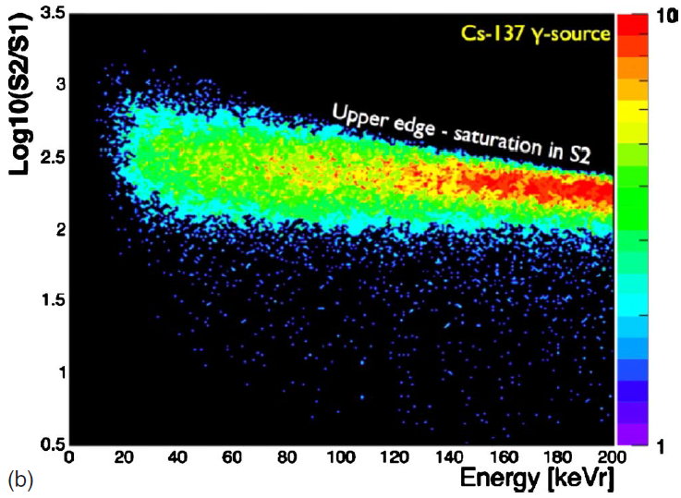
S1 / S2 separation in LXe
LUX experiment
XENON experiment
Notes:
If we use spectrum end point method we can reject background and gamma after radiative capture by spectra subtraction.
In Neutron double-scattering method we should realize another technique.
This technique is based on different ionization density for neutron and gamma, i.e. we will have different S2 S1 ratio.
Top and bottom left images represent logarithmic ratio of S2 and S1 as a function of energy and we can see clear separation between neutron elastic recoil and electron recoil used in XENON experiment
Right picture represent logarithmic ratio of S2 and S1 as a function of S1 used in LUX experiment.

Slide 21


Chamber 3D - view
Notes:
It is 3d model of our installation.
You can see the detector itself on the left picture and detector inside cryogenic chamber on the right picture.
A tube at the bottom of the right image is neutron generator.

